Slide 1

TPCTRAINING.COM

Slide 2

  Chicago
  Denver
  Philadelphia
  North Carolina
  International
Industrial Skills Training Since 1969
  Training products and services to address the global maintenance and
  operations skills shortage and build a better, safer, more efficient workforce.
1,000+
2,000
110,000+
30%
50%
Hours of
training and hands-on simulation content
Scheduled training
classes per year
Active students
Increase in
knowledge gains
Reduction in
equipment downtime

Slide 3
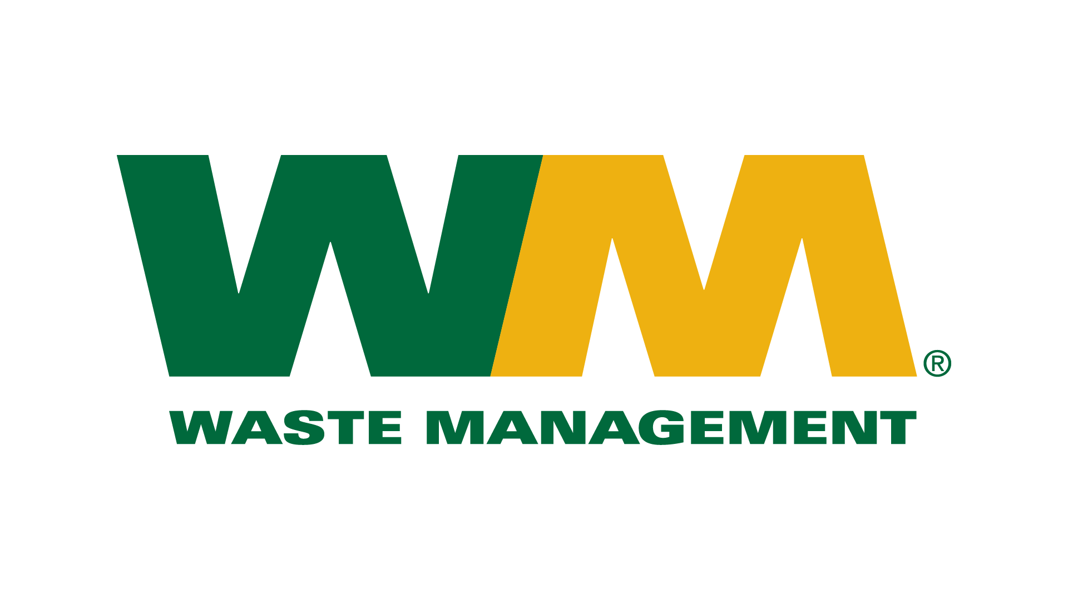
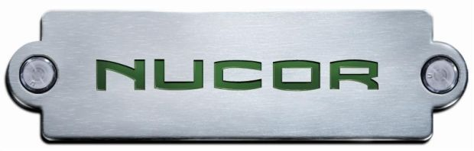



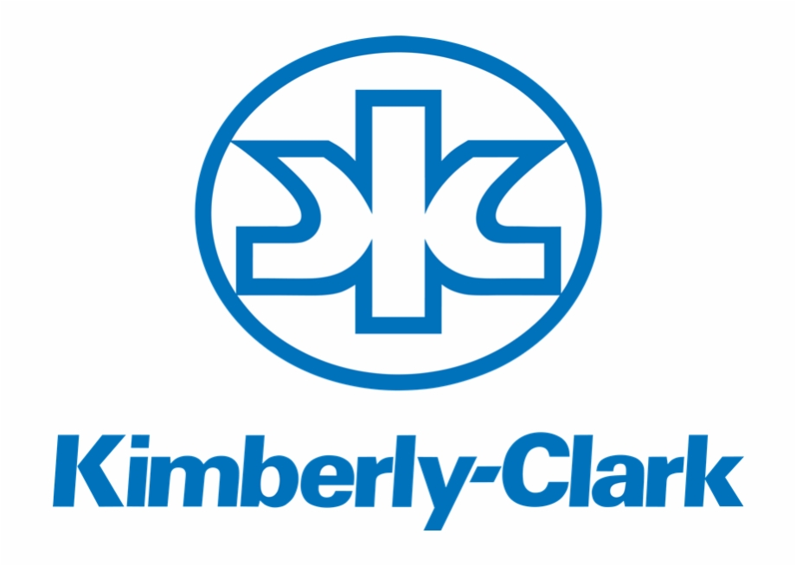


20+
Four decades of industrial training experience
with more than 40,000 clients worldwide
Our SME’s have an average of 20 years industry/training experience
  Choose from our broad portfolio of industry-leading solutions, ranging from online fundamentals to on-the-job machine-specific competencies. We help identify and fill the technical skills gaps in workforces and measure outcomes.
Notes:
Diverse client base allowing us to not be heavy in any one industry.
Ability to weather economic storms.
Client growth and 93% renewal rate.
TPC Instructor-led training.

Slide 4

WHO ARE WE?
TPC Training is the leader in maintenance, repair, and operator training and troubleshooting, with complete solutions for a 21st century workforce to acquire, apply, and adapt essential technical and safety skills. Our solutions include:
Instructor-led training, with more than 2,000 annual classes in seminar, onsite, and virtual formats.
Online training, with 1,000+ technical courses and hands-on simulations managed through FUSION, an industry-leading Learning Management System.
Operator Performance Tools, with customized, just-in-time operator and maintenance training on a mobile platform.
Workforce Management Software
Mobile Verifications & Audits
Continuing Education

Slide 5
Skills Shortage 2015-2025
2.7 million workers will retire in the next ten years (2015-2025).
Expanding U.S. manufacturing operations will need an additional 700,000 workers.
Total of 3.4 million manufacturing workers are likely to be needed over next ten years.
Only 1.4 million jobs are likely to be filled, leaving 2 million jobs unfilled.
The average estimate among the 84% of polled manufacturing executives who thought there was a talent shortage was that 6 out of 10 open skilled production positions remain vacant due to talent shortage.
  Data Source —Deloitte: The skills gap in U.S. manufacturing. 2015 and beyond. Published: 2015
Notes:
I hear from all my clients about their concerns over the looming retirement of skilled workers.
Boeing, International Paper, Nucor Steel, Etc.
Many are predicting losing between 40% to 70% of their skilled workforce to retirement and they don’t have enough available skilled new hires to meet their need.
This a global issue – just completed a large project in Saudi Arabia that is focused on providing skills training to nationals with the goal of nationalizing the workforce and moving expats out of the role of keeping plant an machine operating.

Slide 6
The TPC approach is one of continuous engagement
across all moments of learning need
Core Concepts
On-the-Job
Reinforcement
Skills
LEARN
APPLY
Competency Time
INSTRUCTOR LED TRAINING
ONLINE
OJT ASSESSMENT
OPERATE

Slide 7
Curriculum Alignment
  TPC’s technical and safety training libraries will help establish a core curriculum to match each job function supported by self-study and hands-on training.
  E-Learning / Mobile Forms
  Instructor Guide
  Text Manual
  PowerPoint ISM
  Study Guide
  Assessment

Slide 8

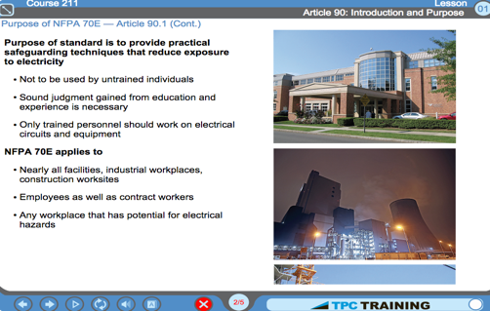
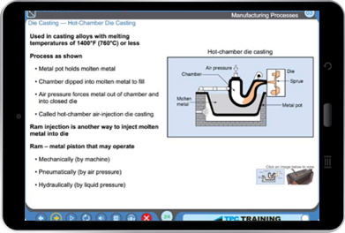
Web-based training through our industry-leading Learning Management System (LMS), FUSION, and the deepest library of technical and safety content and simulations
Core Competencies = Fundamentals, Electrical, Mechanical
Specific Competencies (Process Instrumentation, PLC, Welding, Rigging, etc.)
Modular design allows to develop custom training curricula to meet specific needs
Each Course = 5-10 hour duration (each Lesson is 1 hr)
Deep technical knowledge presented in a practical format
How things work, why they work
Self-study: audio narration, illustrations/animations,
exercises, glossary, study guides

Slide 9
Maintenance, Operator & Technical Skills Library
AC & Refrigeration, Building Grounds and Maintenance, Energy Conservation and Material Handling Systems
AC & Refrigeration
Building Grounds and Maintenance
Energy Conservation
Material Handling Systems
Regulatory Compliance
General Safety and Health
Mechanical Maintenance Applications, Water/Wastewater Treatment,
Maintenance Management, Safety Training
Mechanical Maintenance Applications
Water/Wastewater Treatment
Maintenance Management
Safety Training
Fundamentals, Electrical Systems and Mechanical Systems
Fundamentals
Electrical Systems
Mechanical Systems

